Slide 1



Netflix Movies &TV Shows Recommender System
MC 594 Seminar
Group 1
Garima Bansal (2211MC05)
Konika Mandal (2211MC17)
Nikunj Pansari (2211MC21)

Slide 2


Contents
Introduction
Objective
Data Visualization (using Python)
Model Implementation : Bagging
Analysis
Conclusion
Further Scope
References

Slide 3


Introduction
Choosing a movie or TV show to watch can be difficult at times, when a similar category of movie or shows are available
Thus, there comes the filter of rating
Data analysis of Netflix dataset would be beneficial in building a movie or show recommender system based on some metrics like ratings and few others.

Slide 4


Objective
To analyze the content released by Netflix and gain some insights into the way forward
To identify which genres are most popular and find content that fits their personal preferences
Help users to discover new content according to different age groups

Slide 5
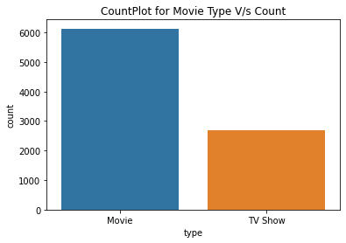
Data Visualization
To show relationship between different attributes, data visualization is important for proper analysis.
Movies are more than TV Shows

Slide 6
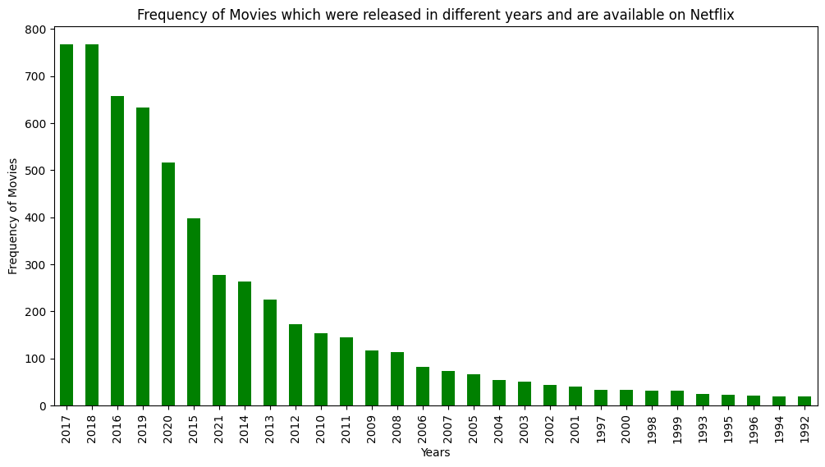
Bar Plot
Highest number of movies were added on Netflix in year 2017-18
Growth rate is increasing slowly every year.

Slide 7
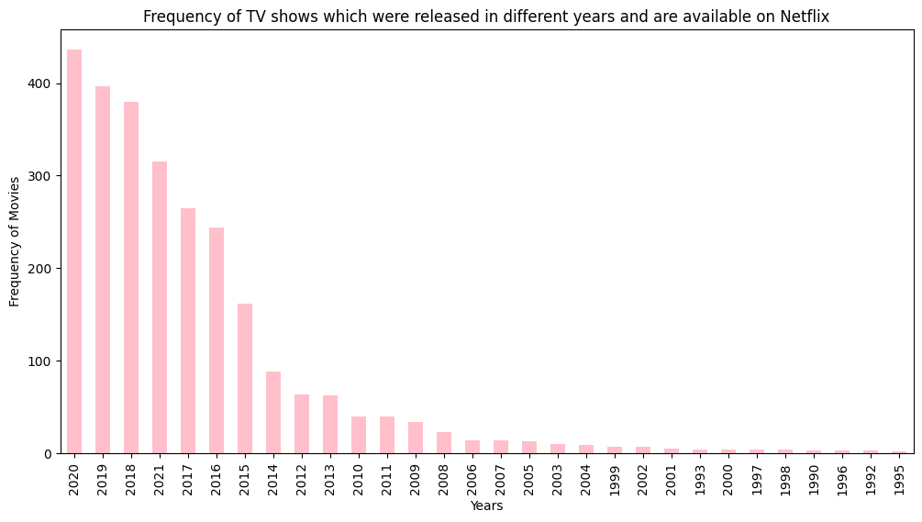
Bar Plot
Highest number of TV Shows were added on Netflix in year 2020
From year 1995-2011 very less TV shows were added each year, after that it increased rapidly

Slide 8

Rating
PG-13
Inappropriate For Children Under 13
TV-MA
Mature Audience Only
PG
Parental Guidance under age 15
TV-14
Unsuitable for children under 14
TV-PG
Parental guidance under age 14
TV-Y
Aimed at age 2-6
TV-Y7
Most appropriate for age 7 and up
R
Under 17 can watch under PG
TV-G
Suitable for general audience contains little or no violence
G
Appropriate for people of all ages
NC-17
No children 17 and under can watch
NR
Not Rated , reviewed but no rating assigned
TV-Y7-FV
Fantasy Violence more than TV-Y7
UR
Unrated , not rated at all

Slide 9
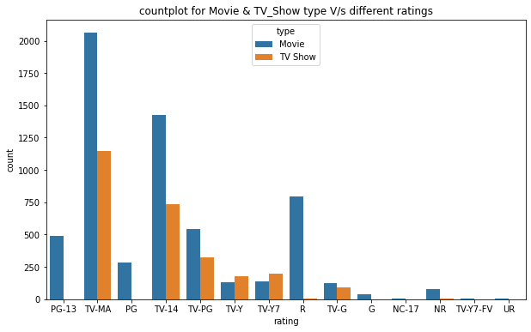
Count Plot
TV- MA rating has highest count for both movies & TV Shows
Mature Audience content is highly demanded

Slide 10
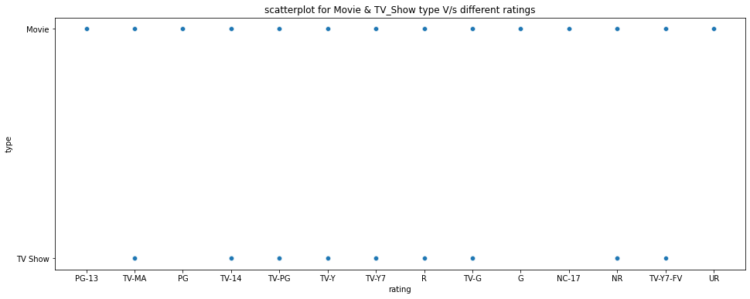
Scatter Plot
Content for movies are available in all types of rating
TV Shows are not available with PG-13, PG, G, NC-17 and UR ratings

Slide 11
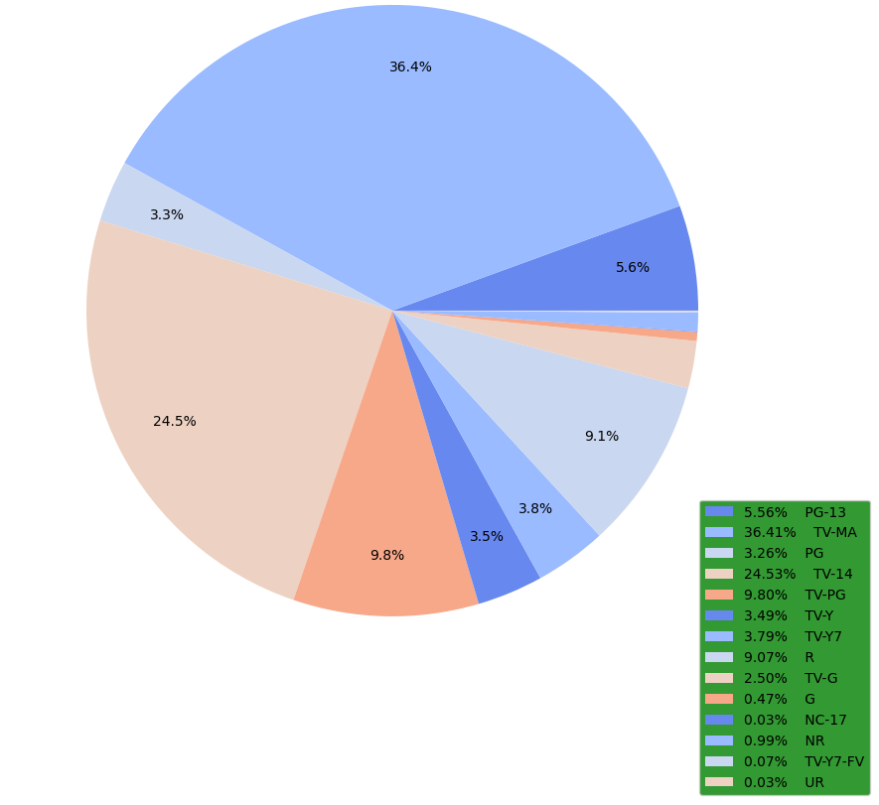
Pie Chart

Slide 12
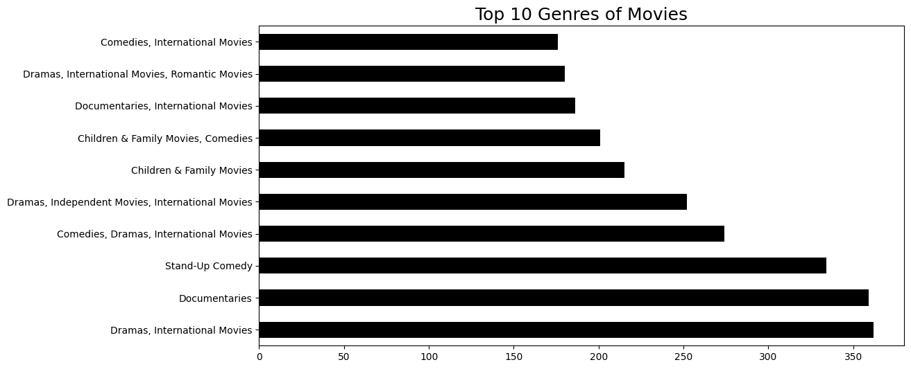
Most of the users are interested in Dramas, International Movies among movies available on
Netflix

Slide 13
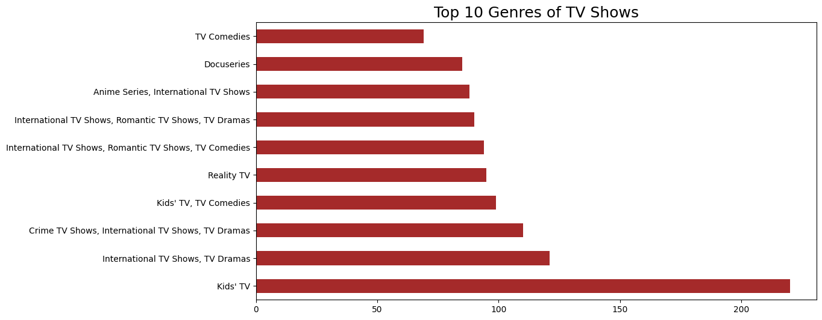
Most of the users are interested in kid’s TV among TV shows available on Netflix

Slide 14
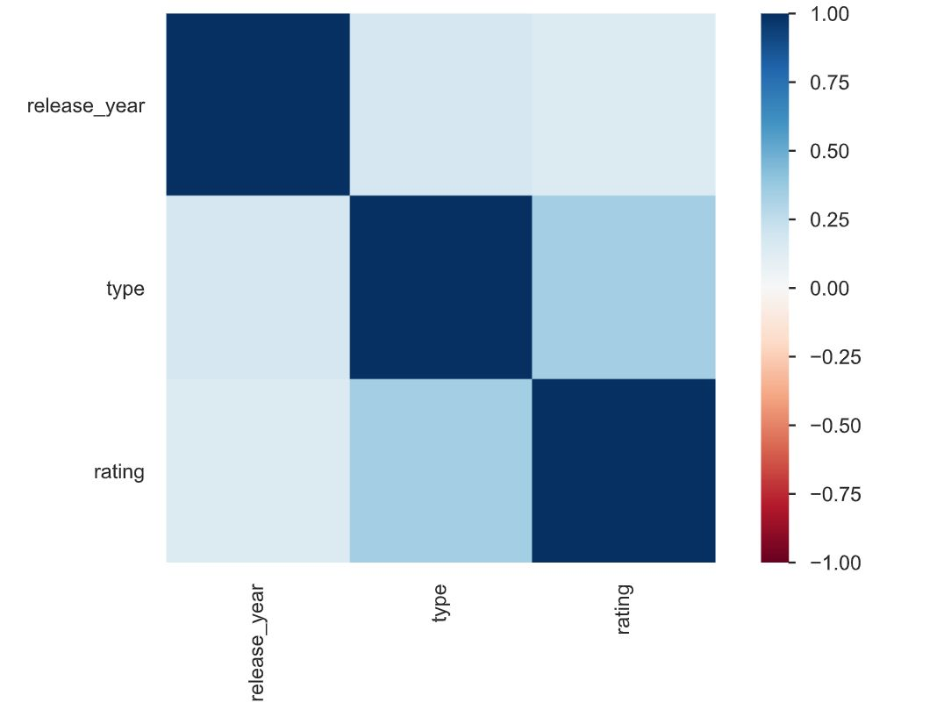
Correlation Matrix
( Heat Map)
The release year directly doesn’t imply the type of the movie or the show
The dark blue color shows a high dependency, light blue shows less dependency between the attributes

Slide 15
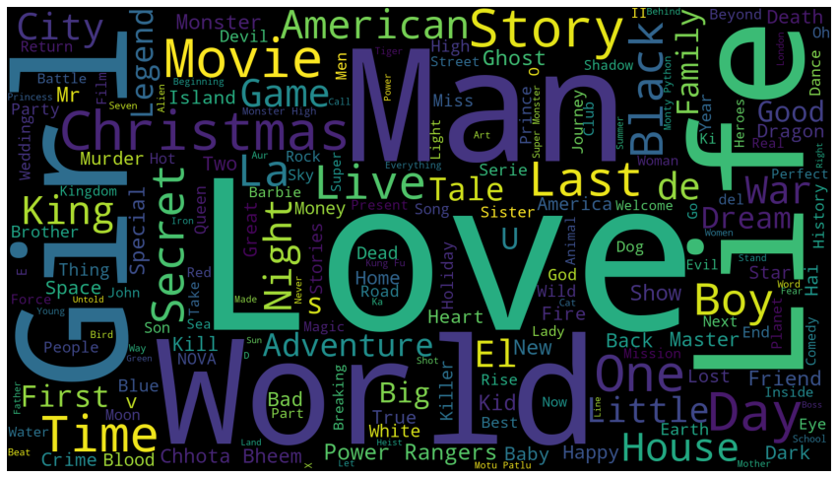
WordCloud
Here the size of each word indicates its importance or frequency in the whole dataset
Frequency of the word “LOVE” is maximum in our dataset

Slide 16
Bagging
Ensemble Learning
Multiple models, often called base models, are combined to produce an effective optimal prediction model
Decision Tree
Used for both regression & classification models
Ensemble learning technique
Involves randomly sampling the training data with replacement
Bootstrap Aggregation
Internal nodes : features
Branches : decision rules
Each leaf node : outcome
Tree-structured classifier

Slide 17
Steps of Bagging Classifier
Pre-processing the data
Splitting the data
Building the Bagging Classifier
Tuning the Hyper parameters
Evaluating the model performance

Slide 18

Why we used this ML Model?
Handling multi-class classification problem
To minimize overfitting of data
To improve accuracy of the model
High-dimensionality of the input data

Slide 19
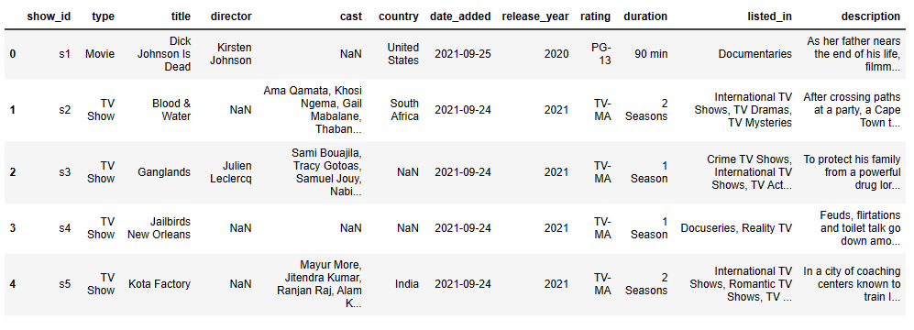
Data Before Encoding

Slide 20
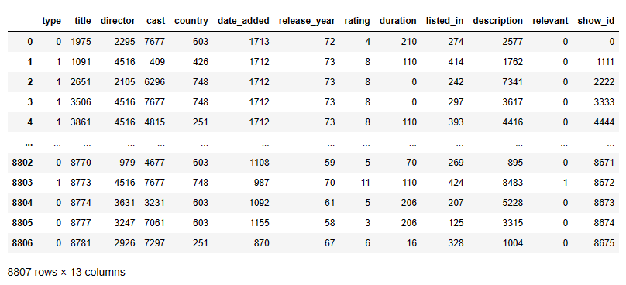
Encoded Data

Slide 21
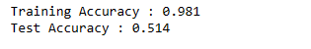
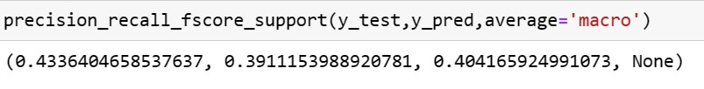
Results & Analysis
Using Bagging classifier on Netflix Movies & TV Shows dataset we can observe that our model’s accuracy on training set is 98% and 51% on test set. (F1- score : 0.4)

Slide 22
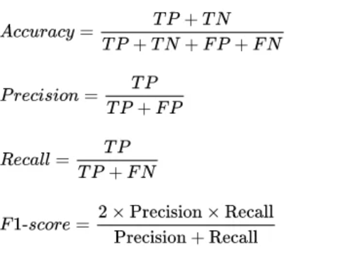
Formulas

Slide 23

Conclusion
The Bagging Classifier is simple & effective for the selection of the movies or TV shows for different age group of people .
The model is not fitting the dataset as is, we need to choose a different model .

Slide 24

Future Scope
Try a different ensemble method like boosting, or stacking
Hyperparameter tuning
Different type of algorithms can be used such as matrix factorization or Deep Learning models which are specifically designed for collaborative filtering

Slide 25
Contributions
Garima Bansal (2211MC05) : 33.33%
Konika Mandal (2211MC17 ) : 33.33%
Nikunj Pansari (2211MC21 ) : 33.33%

Slide 26
References
https://www.kaggle.com/datasets/shivamb/netflixshowsdatasetId=434238&sortBy=voteCount
https://github.com/shinanna/Netflix_MachineLearning
Vybhav Achar Bhargav, Seongwoo Choi, and David Haddad. Dataanalysis on netflix datasets. 03 2022
Karthik Babu Vadloori and Shriya Madhavi Sanghishetty. Exploratory and sentiment analysis of netflix data. International Journal of Engineering Research & Technology (IJERT), 10(9):213–217, 2021

Slide 27

Thank You!!
Any Questions !!

